Slide 1
Algorithms Directed Graphs
CSE 464/574
Spring 2019

Slide 2
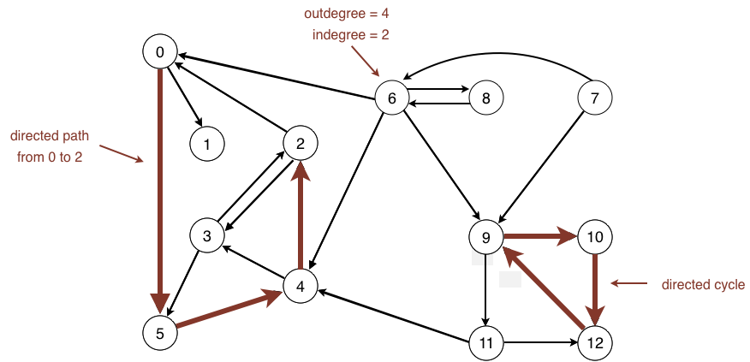
Directed Graphs -- digraphs
Digraph: Set of vertices connected pairwise by directed edges.
outdegree, indegree, directed path, directed cycle

Slide 3
Some digraph problems
problem | description
s→t path | Is there a path from s to t ?
shortest s→t path | What is the shortest path from s to t ?
directed cycle | Is there a directed cycle in the graph ?
topological sort | Can the digraph be drawn so that all edges point upwards?
strong connectivity | Is there a directed path between all pairs of vertices ?
transitive closure | For which vertices v and w is there a directed path from v to w ?
PageRank | What is the importance of a web page ?

Slide 4
Digraph API
public class Digraph
 | Digraph(int V) | create an empty digraph with V vertices
 | Digraph(In in) | create a digraph from input stream
void | addEdge(int v, int w) | add a directed edge v→w
Iterable<Integer> | adj(int v) | vertices pointing from v
int | V() | number of vertices
int | E() | number of edges
Digraph | reverse() | reverse of this digraph
String | toString() | string representation

Slide 5
Digraph representationS:
set of edges
Store a list of the edges (linked list or array)
adjacency matrix
Maintain a two-dimensional V-by-V boolean array; for each edge v→w in the digraph: adj[v][w] = true.
adjacency lists
Maintain vertex-indexed array of lists.

Slide 6
Digraph representations
In practice. Use adjacency-lists representation.
Algorithms based on iterating over vertices pointing from v.
Real-world digraphs tend to be sparse.
representation | space | insert edge from v to w | edge from v to w? | iterate over vertices pointing from v?
list of edges | E | 1 | E | E
adjacency matrix | V ² | 1† | 1 | V
adjacency lists | E + V | 1 | outdegree(v) | outdegree(v)
† disallows parallel edges

Slide 7
Adjacency-lists graph code: graphs vs digraphs
For graphs:
public void addEdge(int v, int w)
{
adj[v].add(w);
adj[w].add(v);
}
For digraphs:
public void addEdge(int v, int w)
{
adj[v].add(w);
}

Slide 8
Depth-first search in digraphs
Same method as for undirected graphs.
Every undirected graph is a digraph (with edges in both directions).
DFS is a digraph algorithm.

Slide 9
Reachability application: program control-flow analysis
Every program is a digraph.
Vertex = basic block of instructions (straight-line program).
Edge = jump.
Dead-code elimination.
Find (and remove) unreachable code.
Infinite-loop detection.
Determine whether exit is unreachable.

Slide 10
Reachability application: mark-sweep garbage collector
Every data structure is a digraph.
Vertex = object.
Edge = reference.
Roots.
Objects known to be directly accessible by program (e.g., stack).
Reachable objects.
Objects indirectly accessible by program (starting at a root and following a chain of pointers).

Slide 11
mark-sweep garbage collector
Mark-sweep algorithm. [McCarthy, 1960]
Mark: mark all reachable objects.
Sweep: if object is unmarked, it is garbage (so add to free list).
Memory cost. Uses 1 extra mark bit per object (plus DFS stack).

Slide 12
Breadth-first search in digraphs
Same method as for undirected graphs.
Every undirected graph is a digraph (with edges in both directions).
BFS is a digraph algorithm.
Proposition. BFS computes shortest paths (fewest number of edges) from s to all other vertices in a digraph in time proportional to E + V.

Slide 13
Multiple-source shortest paths
Multiple-source shortest paths.
Given a digraph and a set of source vertices, find shortest path from any vertex in the set to each other vertex.
Example: S = { 1, 7, 10 }.
Shortest path to 4 is 7→6→4.
Shortest path to 5 is 7→6→0→5.
Shortest path to 12 is 10→12.
…
Question: How to implement multi-source shortest paths algorithm?
Answer: Use BFS, but initialize by enqueuing all source vertices.

Slide 14
Breadth-first search in digraphs application: web crawler
Goal. Crawl web, starting from some root web page, say www.miamiOH.edu.
Solution. [BFS with implicit digraph]
Choose root web page as source s.
Maintain a Queue of websites to explore.
Maintain a SET of discovered websites.
Dequeue the next website and enqueue websites to which it links (provided you haven't done so before).
Q. Why not use DFS?

Slide 15
Depth-first search orders
Observation. DFS visits each vertex exactly once. The order in which it does so can be important.
Orderings.
Preorder: order in which dfs() is called.
Postorder: order in which dfs() returns.
Reverse postorder: reverse order in which dfs() returns.
private void dfs(Graph G, int v)
{
marked[v] = true;
preorder.enqueue(v);
for (int w : G.adj(v))
if (!marked[w]) dfs(G, w);
postorder.enqueue(v);
reversePostorder.push(v);
}

Slide 16
Precedence scheduling
Goal.
Given a set of tasks to be completed with precedence constraints, in which order should we schedule the tasks?
Digraph model.
vertex = task;
edge = precedence constraint.

Slide 17
Tasks:
0. Algorithms
1. Complexity Theory
2. Artificial Intelligence
3. Intro to CS
4. Cryptography
5. Scientific Computing
6. Discrete Math
Precedence
Algorithms (0) before 1, 2, 3
Complexity Theory (1) before 4
AI (2): before none
Intro to CS (3) before 2, 4, 5, 6
Cryptography (4) before none
Scientific Computing (5) before 2
Discrete Math (6): before 0, 4

Slide 18
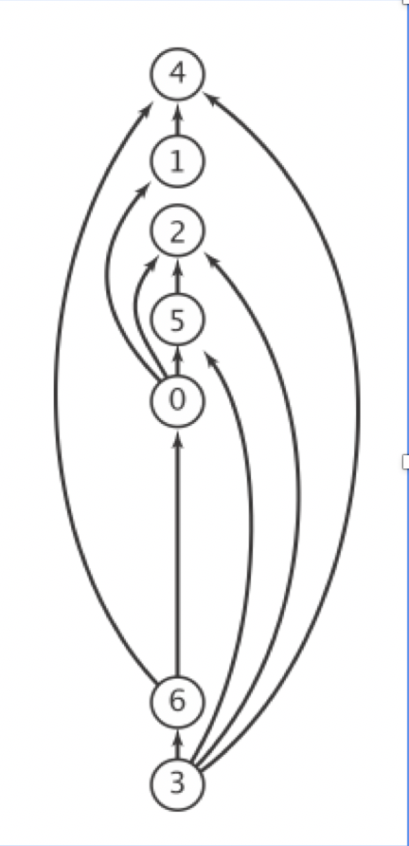
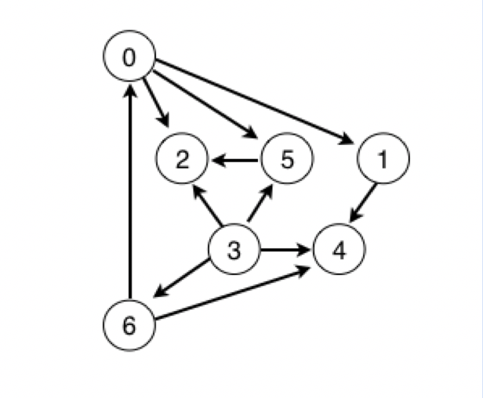
Feasible schedule:
3. Intro to CS
6. Discrete Math
0. Algorithms
5. Scientific Computing
2. Artificial Intelligence
1. Complexity Theory
4. Cryptography
Precedence constraint graph
feasible schedule

Slide 19
Topological sort
DAG
Directed acyclic graph.
Topological sort. Redraw DAG so all edges point upwards.
Solution.
DFS.
Run depth-first search.
Return vertices in reverse postorder.

Slide 20
Topological Sort
public class DepthFirstOrder
{
private boolean[] marked;
private Stack<Integer> reversePostorder;
public DepthFirstOrder(Digraph G)
{
reversePostorder = new Stack<Integer>();
marked = new boolean[G.V()];
for (int v = 0; v < G.V(); v++)
if (!marked[v]) dfs(G, v);
}
private void dfs(Digraph G, int v)
{
marked[v] = true;
for (int w : G.adj(v))
if (!marked[w]) dfs(G, w);
reversePostorder.push(v);
}
public Iterable<Integer> reversePostorder()
{ return reversePostorder; }
}

Slide 21
Topological sort in a DAG: correctness proof
Proposition. Reverse DFS postorder of a DAG is a topological order.
Proof: Consider any edge v→w.
When dfs(v) is called:
Case 1: dfs(w) has already been called and returned.
Thus, w is on the stack before v.
Case 2: dfs(w) has not yet been called.
dfs(w) will get called directly or indirectly by dfs(v) and will finish before dfs(v).
Thus, w is on the stack before v.
Case 3: dfs(w) has already been called, but has not yet returned.
Can’t happen in a DAG: function call stack contains path from w to v, so v→w would complete a cycle.

Slide 22
Directed cycle detection
Proposition. A digraph has a topological order iff no directed cycle.
Proof:
If directed cycle, topological order impossible.
If no directed cycle, DFS-based algorithm finds a topological order.
Goal. Given a digraph, find a directed cycle.
Solution. DFS. What else?

Slide 23
Directed cycle detection application: cyclic inheritance
The Java compiler does cycle detection.
public class A extends B
public class B extends C
public class C extends A
% javac A.java
A.java:1: cyclic inheritance involving A
public class A extends B { }
^
1 error

Slide 24
Directed cycle detection applications
Causalities.
Compilation units.
Class inheritance.
Course prerequisites.
Deadlocking detection.
Precedence scheduling.
Temporal dependencies.
Pipeline of computing jobs.
Check for symbolic link loop.
Evaluate formula in spreadsheet.

Slide 25
Strongly-connected components
Definition: Vertices v and w are strongly connected if there is both a directed path from v to w and a directed path from w to v.
Key property. Strong connectivity is an equivalence relation:
v is strongly connected to v.
If v is strongly connected to w, then w is strongly connected to v.
If v is strongly connected to w and w to x, then v is strongly connected to x.
Definition: A strong component is a maximal subset of strongly-connected vertices.

Slide 26
Connected components versus strongly-connected components
v and w are connected if there is a path between v and w
v and w are strongly connected if there is both a directed path from v to w and a directed path from w to v

Slide 27
Transpose graphs
Original
Transpose
Flip all edges
Why transpose? Look at adjacency matrix
G and G^{T} have same SCCs

Slide 28
SCC Algorithm
Compute DFS(G) : O(V+E)
Compute G^{T} (use adjacency lists!) O(V+E)
Compute DFS(G^{T}), but...
In main loop of DFS, visit vertices in order of decreasing finish time from G O(V+E)
Each DFS tree in the forest from step 3 is a SCC

Slide 29
SCC Algorithm
Original
Transpose
9:12
1
9
1:4
7
6
7:8
6:7
10:11
2:3
10
2
1
1:6
5
1:6
5:12
3
3:4
3:4
2
2:5
8:11
2:5
8
9
9:10

Slide 30
Component graph
One vertex for each SCC
Original G
G^{SCC}
G^{SCC} is always a DAG

Slide 31
Why does SCC algorithm work?
If u and v in different SCCs, and there is a u --> v path in G, then no u --> v path in G^{T}
Visit SCCs in G^{T} in reverse topo sort
Everything reachable from this SCC is either in the SCC, or has already been colored
G
G^{T}

